Slide 1


























GSA Grasshopper Plugin
Dim
Annotation text
1
Highlight something
2
Highlight something
SSN.E - Parametric Design for Structures
10th February 2021
Kristjan Nielsen

Slide 2
Overview
Workflow and Apps EcoSystem

Slide 3
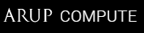





ArupCompute
DesignCheck
Rhino
Grasshopper
Total Design Automation
GSA Grasshopper
Speckle
Speckle Server
GsaAPI
Headless GSA
GSA
AdSec
Local computer
Cloud
Overview Workflow and Eco system of connected applications

Slide 4

Installing Plugin
Using Rhino Package Manager

Slide 5
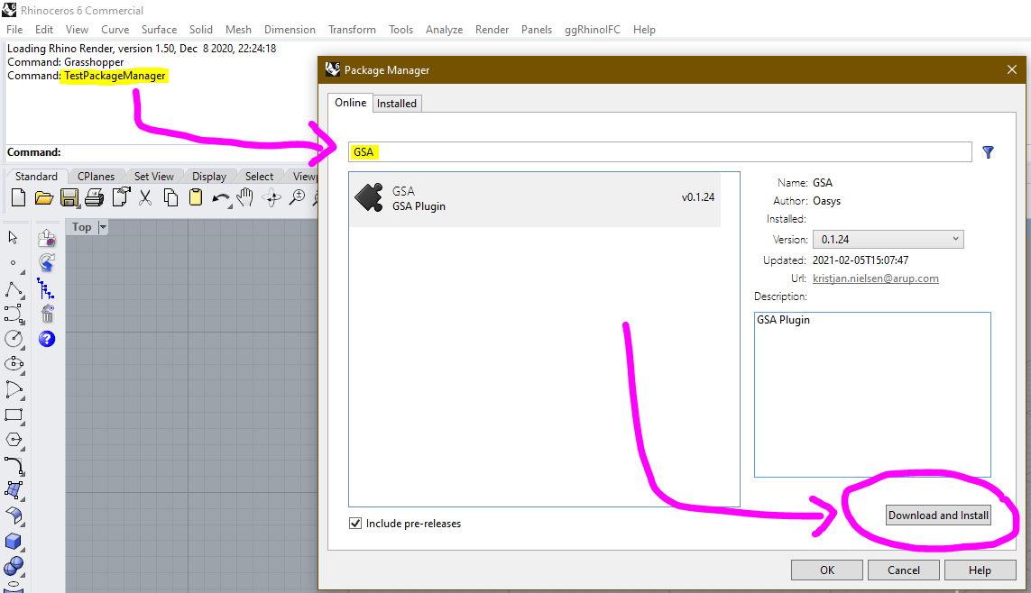
1
2
Rhino6 Command:
TestPackageManager
3
Installing GSA-Grasshopper

Slide 6
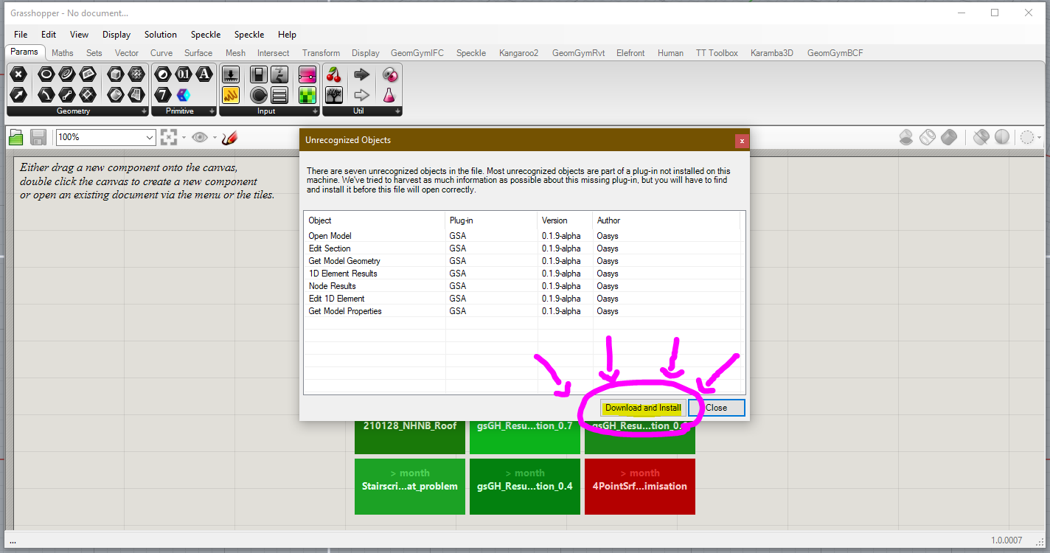
Installing GSA-Grasshopper

Slide 7
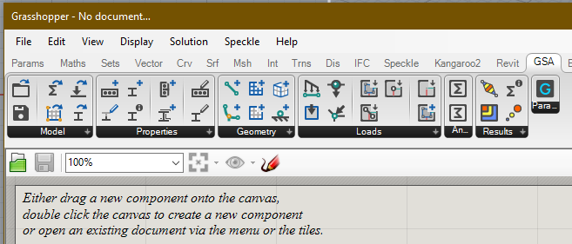
Overview
Plugin Sub-Categories

Slide 8









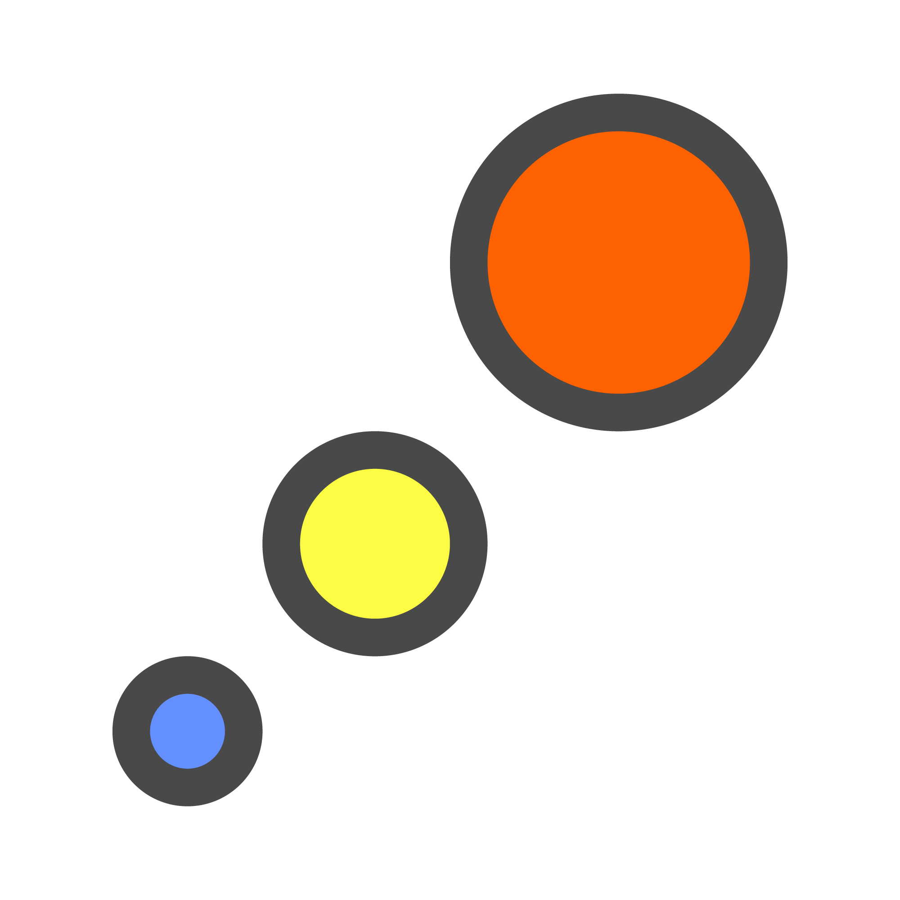



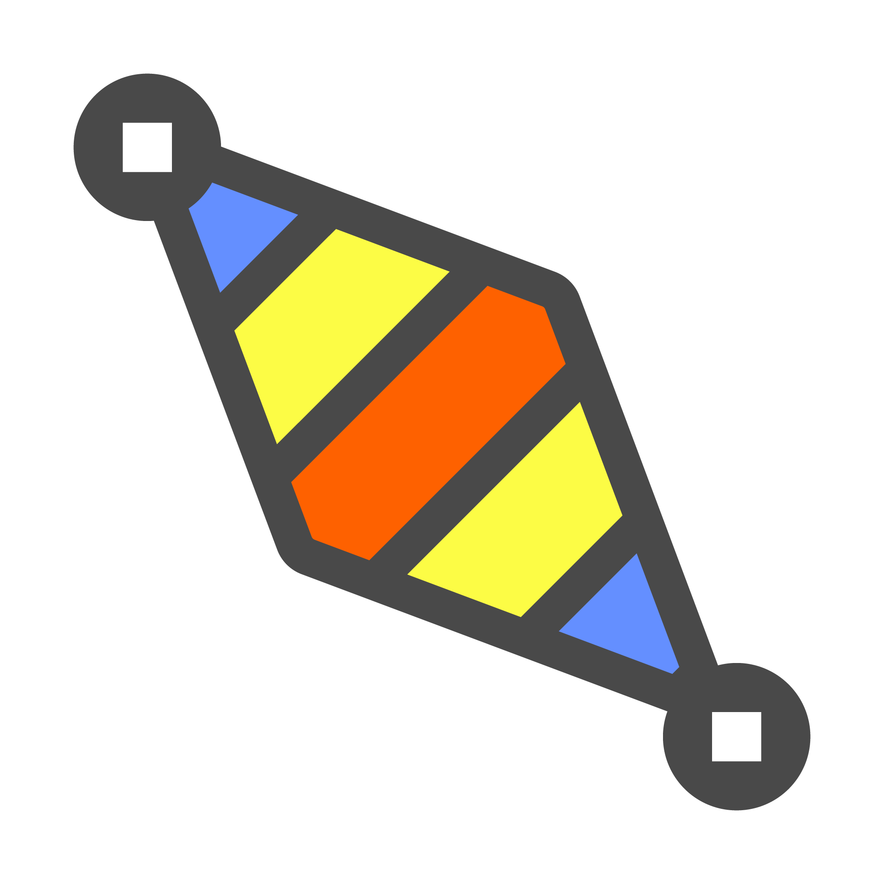





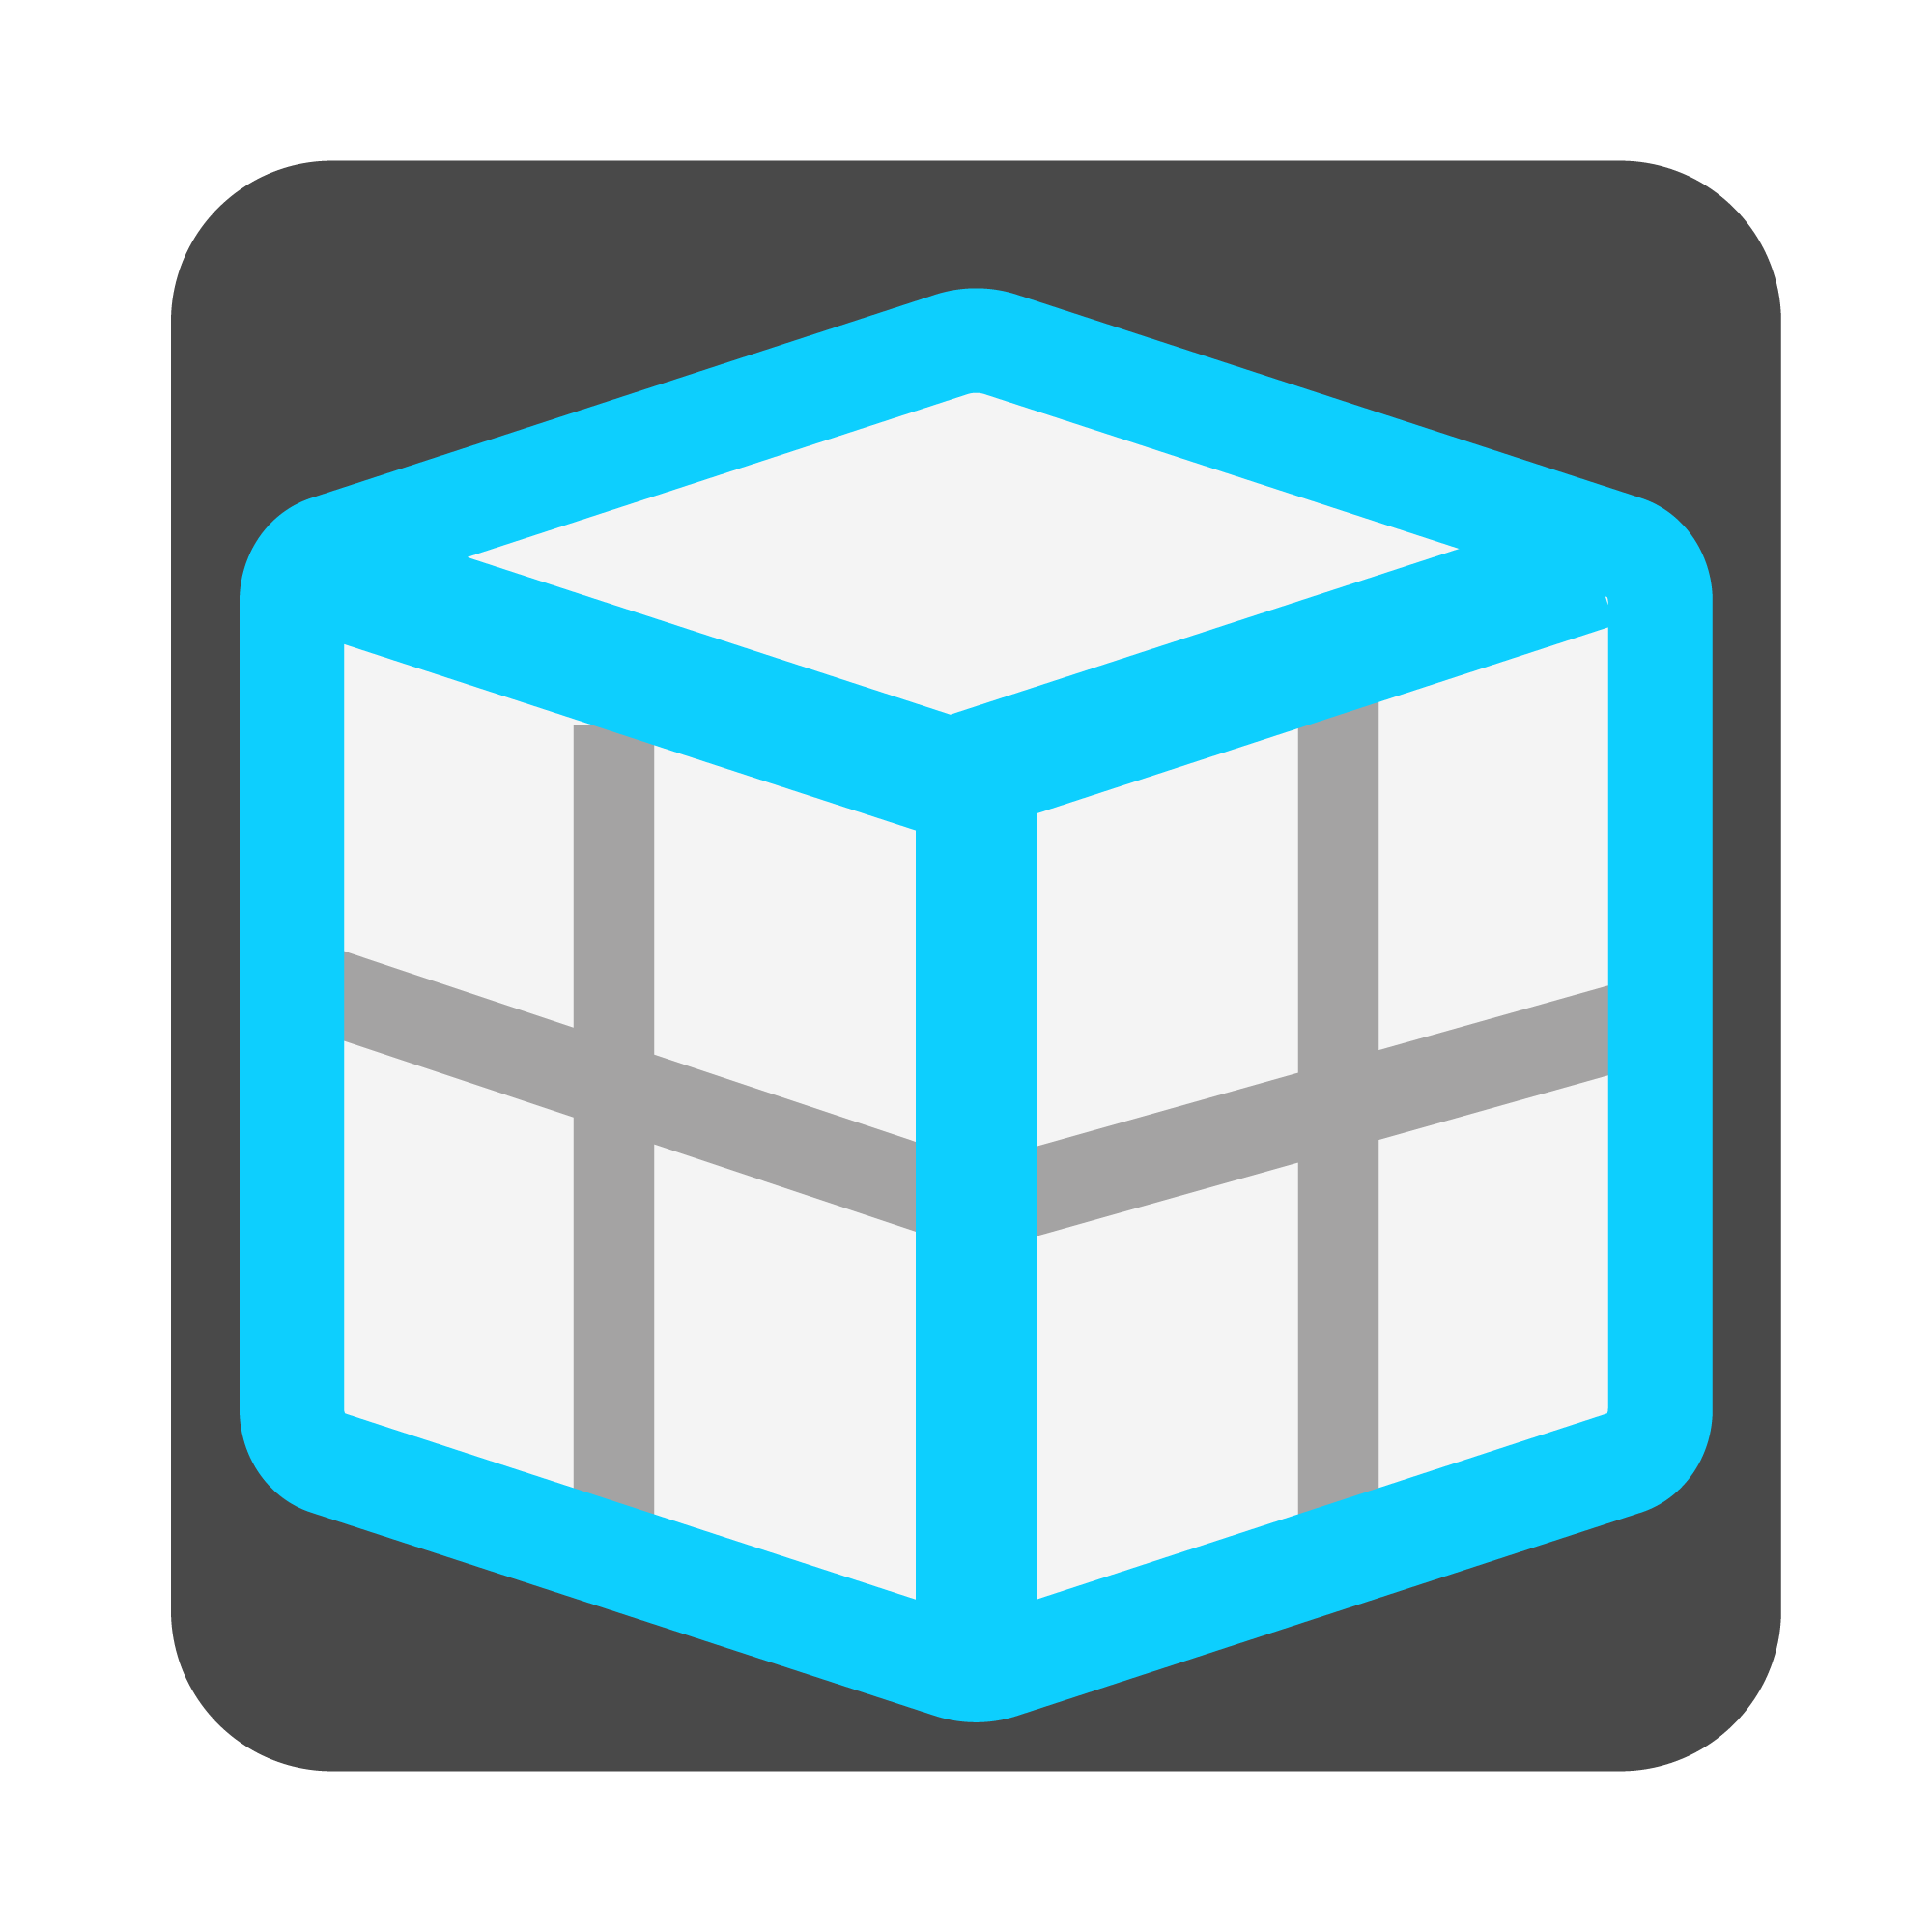
Model
GSA Model
GSA Model
Open Model
Save Model
Properties
Section
Prop2D
Offset
Spring
Bool6
Geometry
Node
Element1D
Element2D
Member1D
Member2D
Member3D
Loads
Load
GridPlnSrf
Node Res.
1D Results
2D Results
Analyse
Results
Overview Plugin workflow

Slide 9
Model
GSA Model
GSA Model
Open Model
Save Model
Properties
Section
Prop2D
Offset
Spring
Bool6
Geometry
Node
Element1D
Element2D
Member1D
Member2D
Member3D
Loads
Load
GridPlnSrf
Node Res.
1D Results
2D Results
Analyse
Results
Overview Plugin workflow

Slide 10
Model

Slide 11
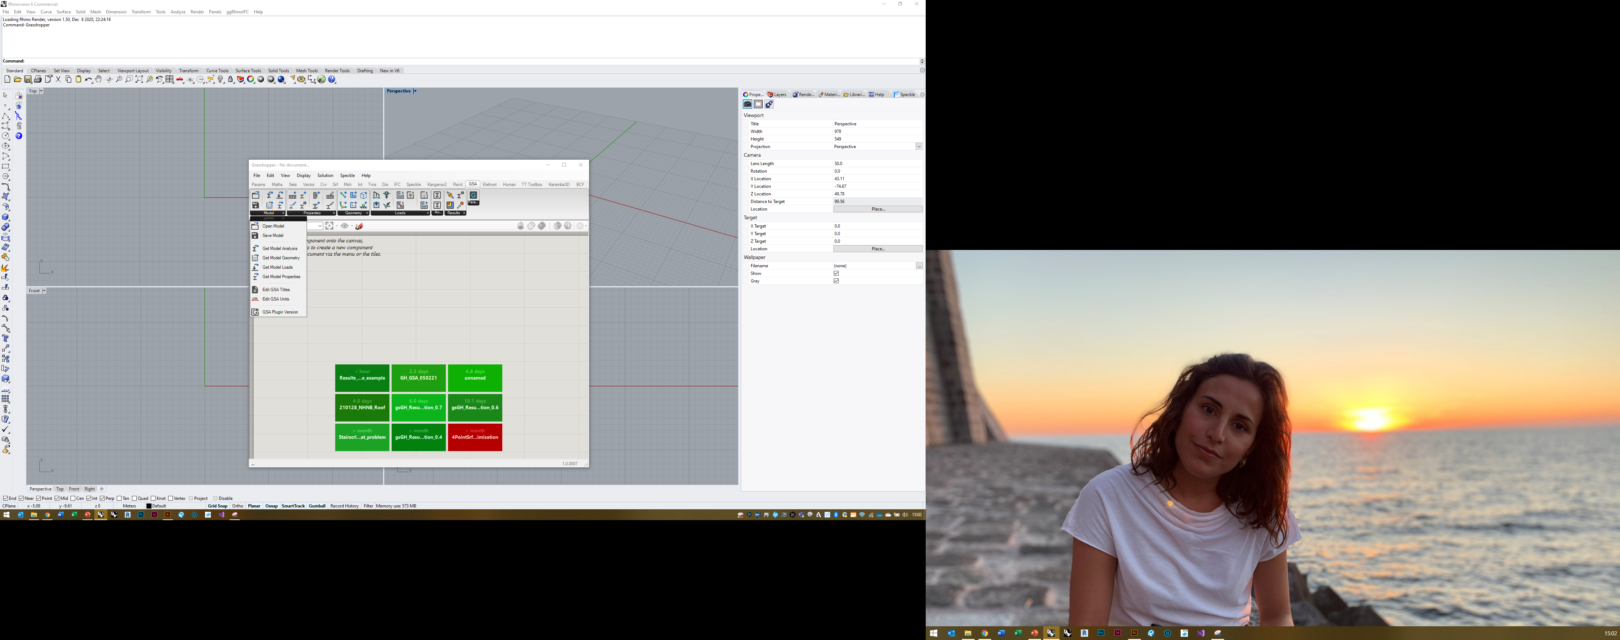
Model tab

Slide 12
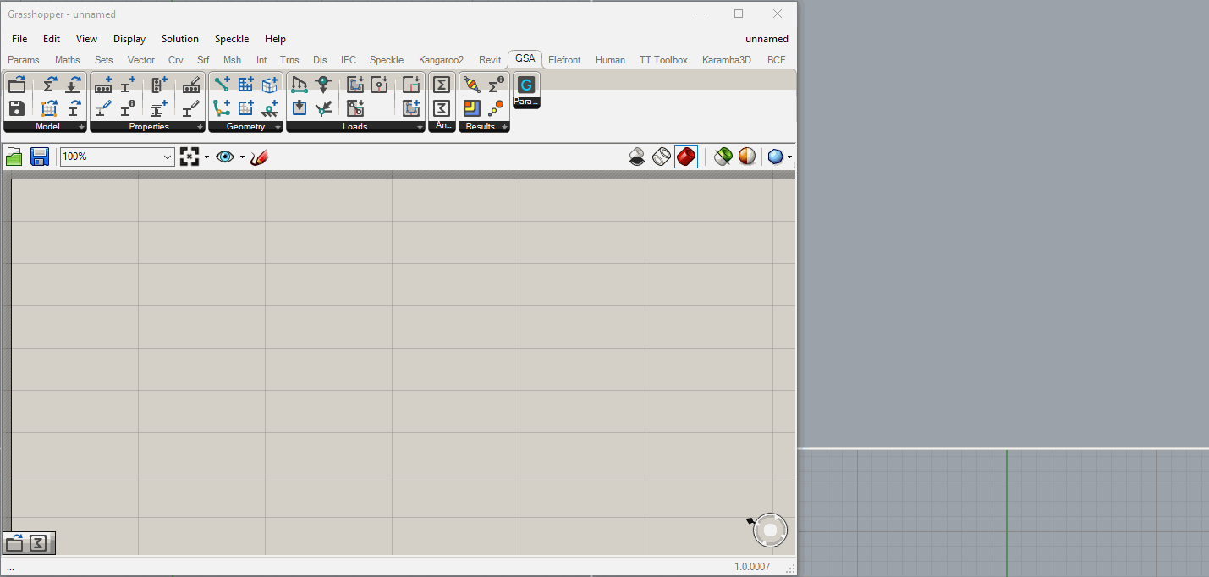
Open Model & Get Geometry

Slide 13
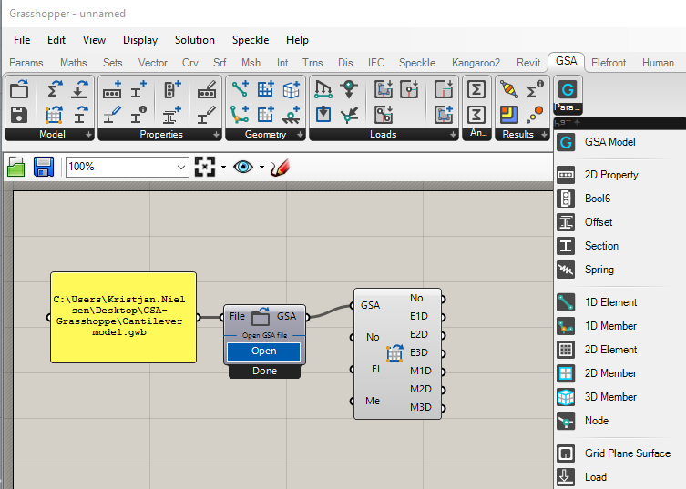
GSA Grasshopper Parameters

Slide 14
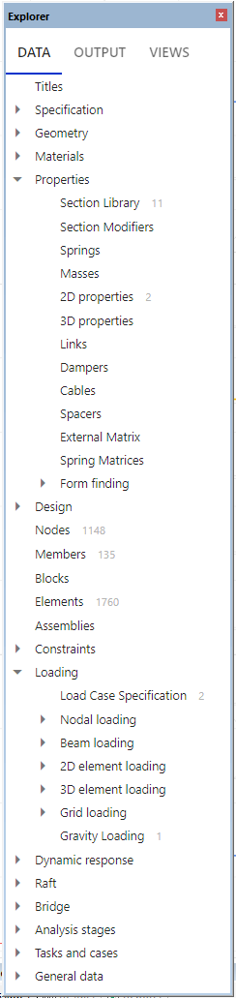
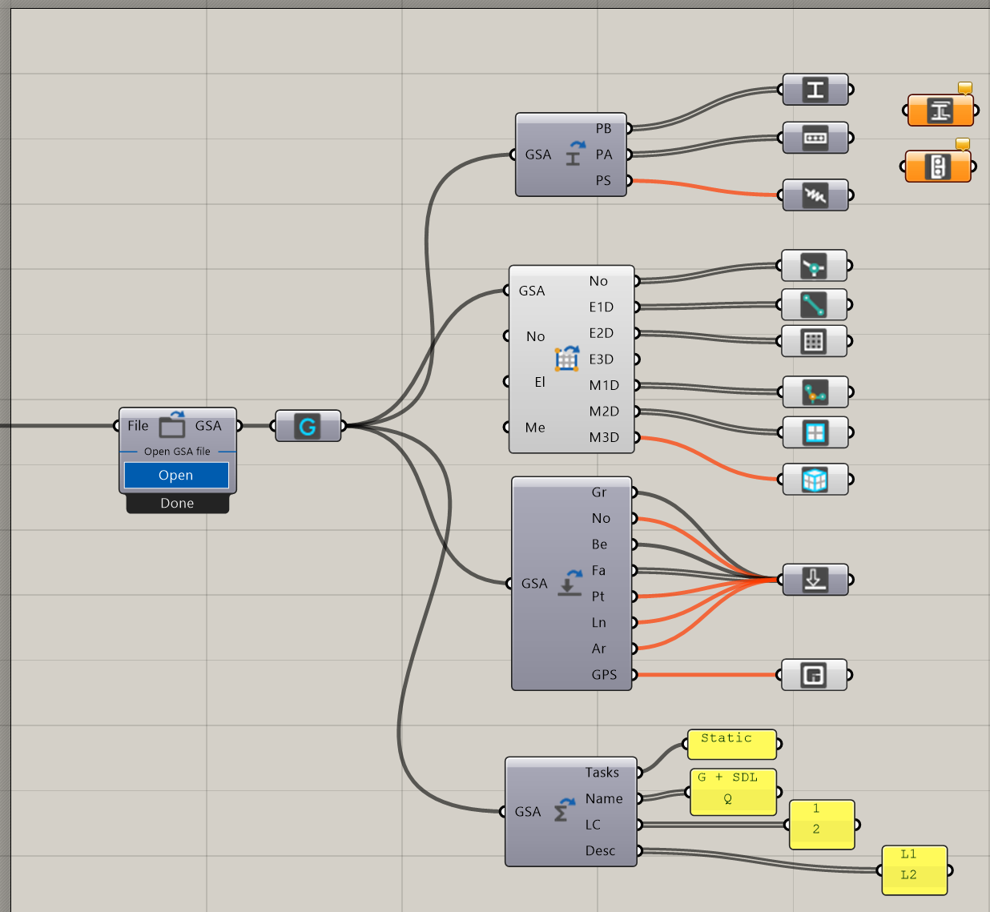
GSA Grasshopper Parameters – GSA Reference

Slide 15
Properties

Slide 16
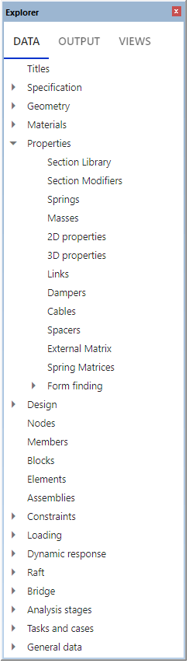
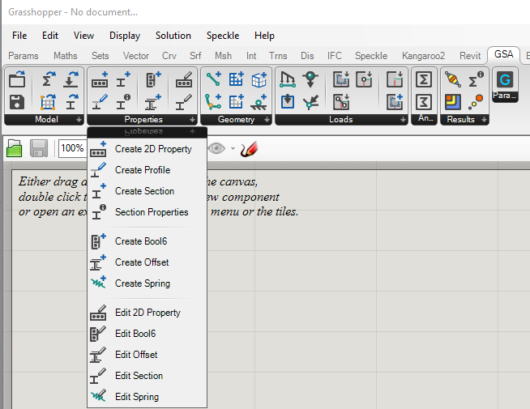
Properties tab

Slide 17
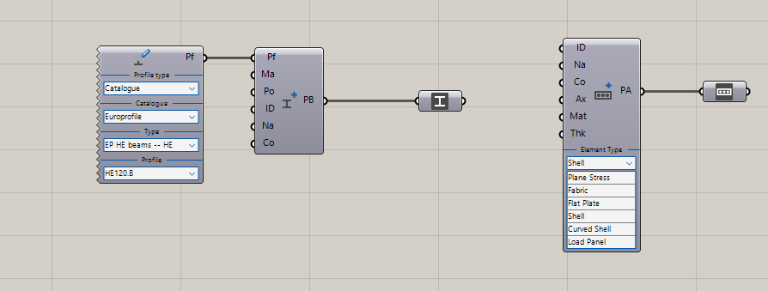
Create Properties Examples [Live Demo]

Slide 18
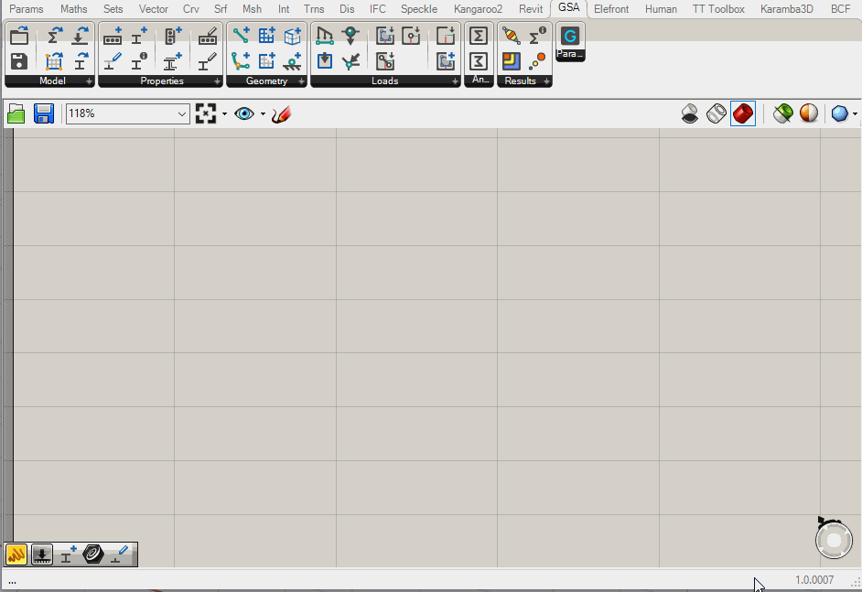
Create Profile

Slide 19
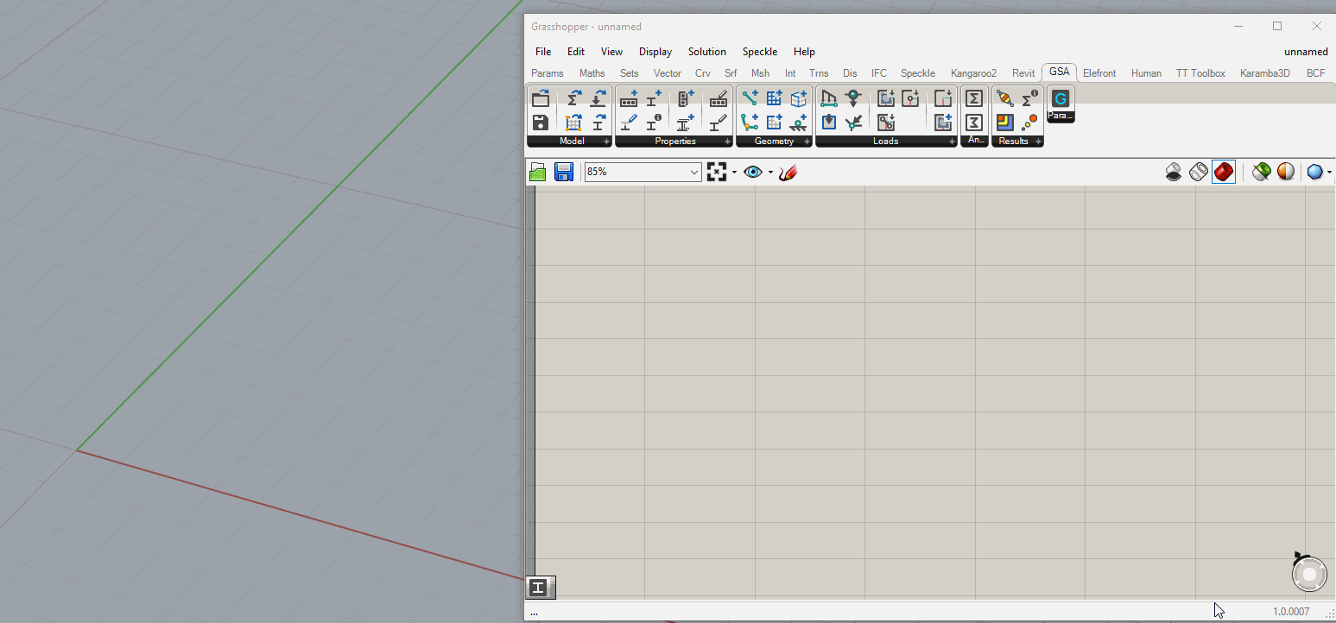
Create Geometric Section

Slide 20
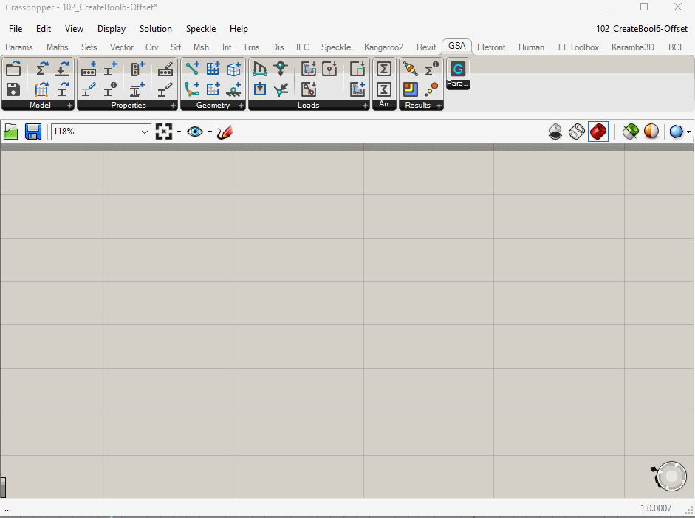
Create and Edit Bool6 Parameter

Slide 21
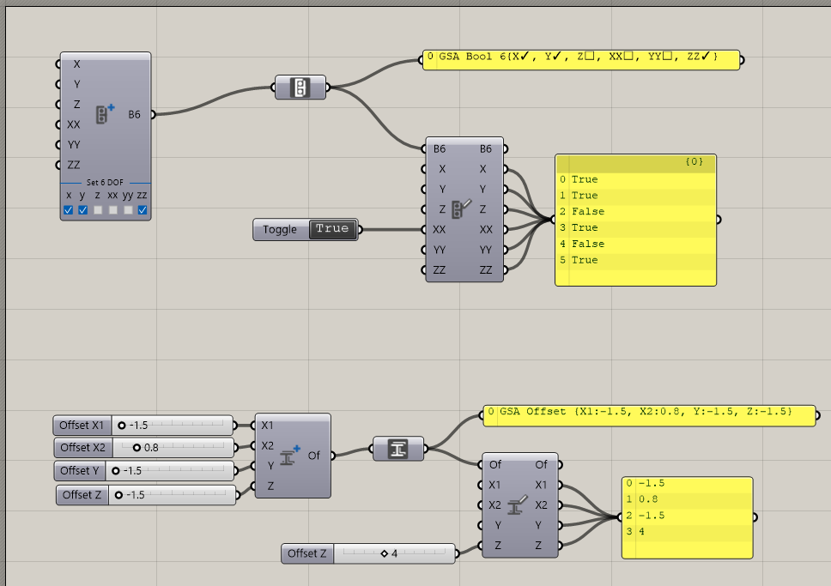
Bool6 and Offset Properties

Slide 22
Geometry

Slide 23
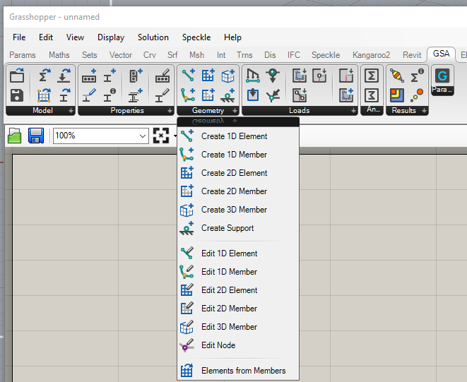
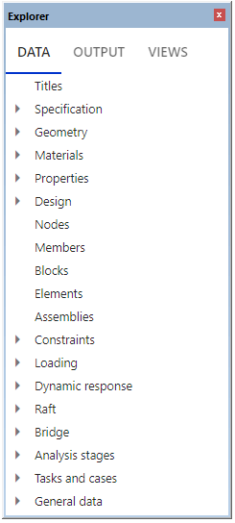
Geometry tab

Slide 24

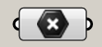

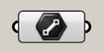

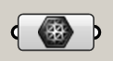

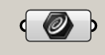

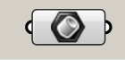

0D
Node
Point3D
(x, y, z)
1D
Element1D
Line
(x₁, y₁, z₁, x₂, y₂, z₂)
2D
Element2D
Mesh
(Verticies, FaceList)
1D
Member1D
PolyCurve (Arc or Polyline)
(TopologyList)
Nurbs crv auto-converted to Arc or Polyline
2D
BRep auto-converted to planar
Nurbs edges and incl. Crvs auto-converted to Arcs and Lines
Inclusion Pts and Crvs auto-projected onto plane
Member2D
Planar BRep (Edges, inc.Lines, inc.Pts)
3D
Member3D
Solid (Closed Mesh) (Verticies, FaceList)
BRep auo-capped if not closed
BRep auto-converted to mesh
Rhino/GH Geometry correlation with GSA Geometry

Slide 25
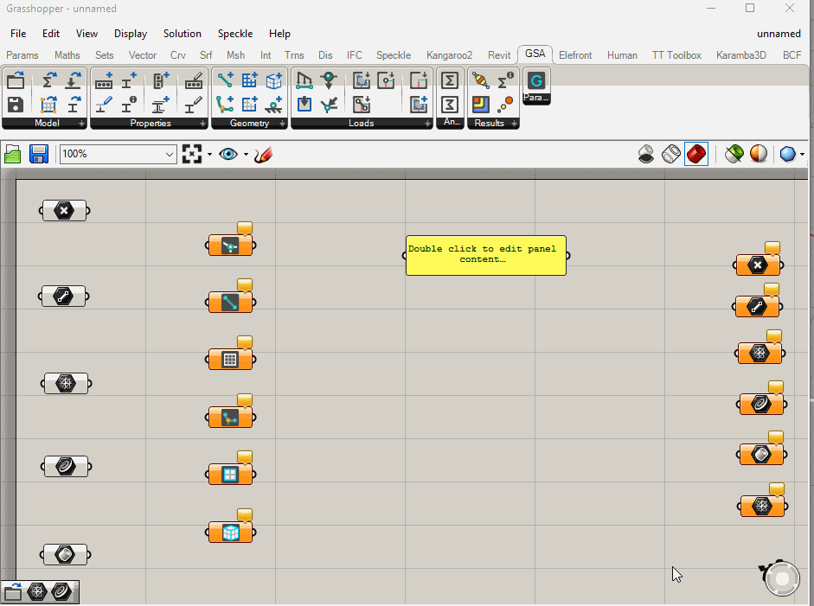
On-the-fly conversions

Slide 26
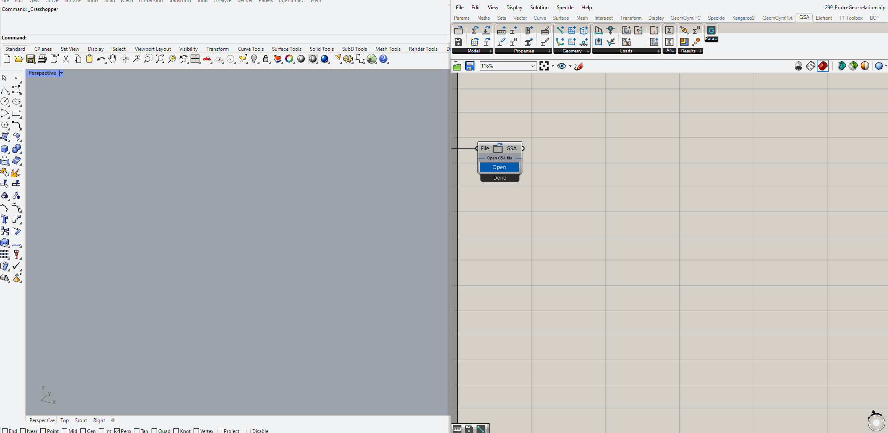
On-the-fly conversions with Existing GSA Model

Slide 27
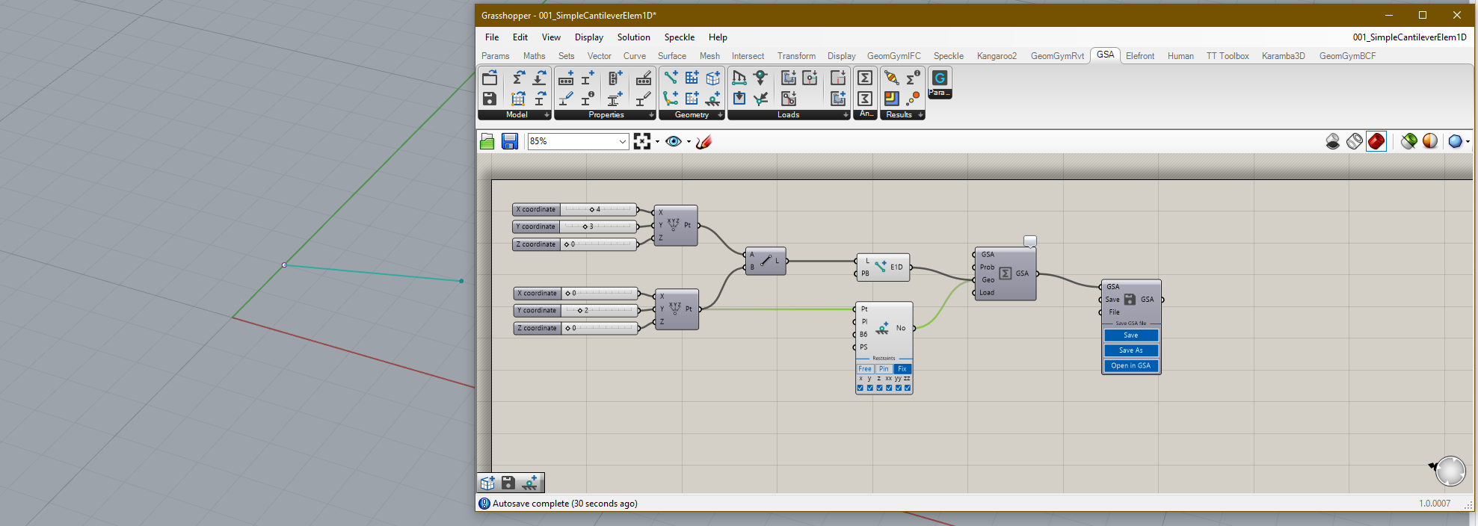
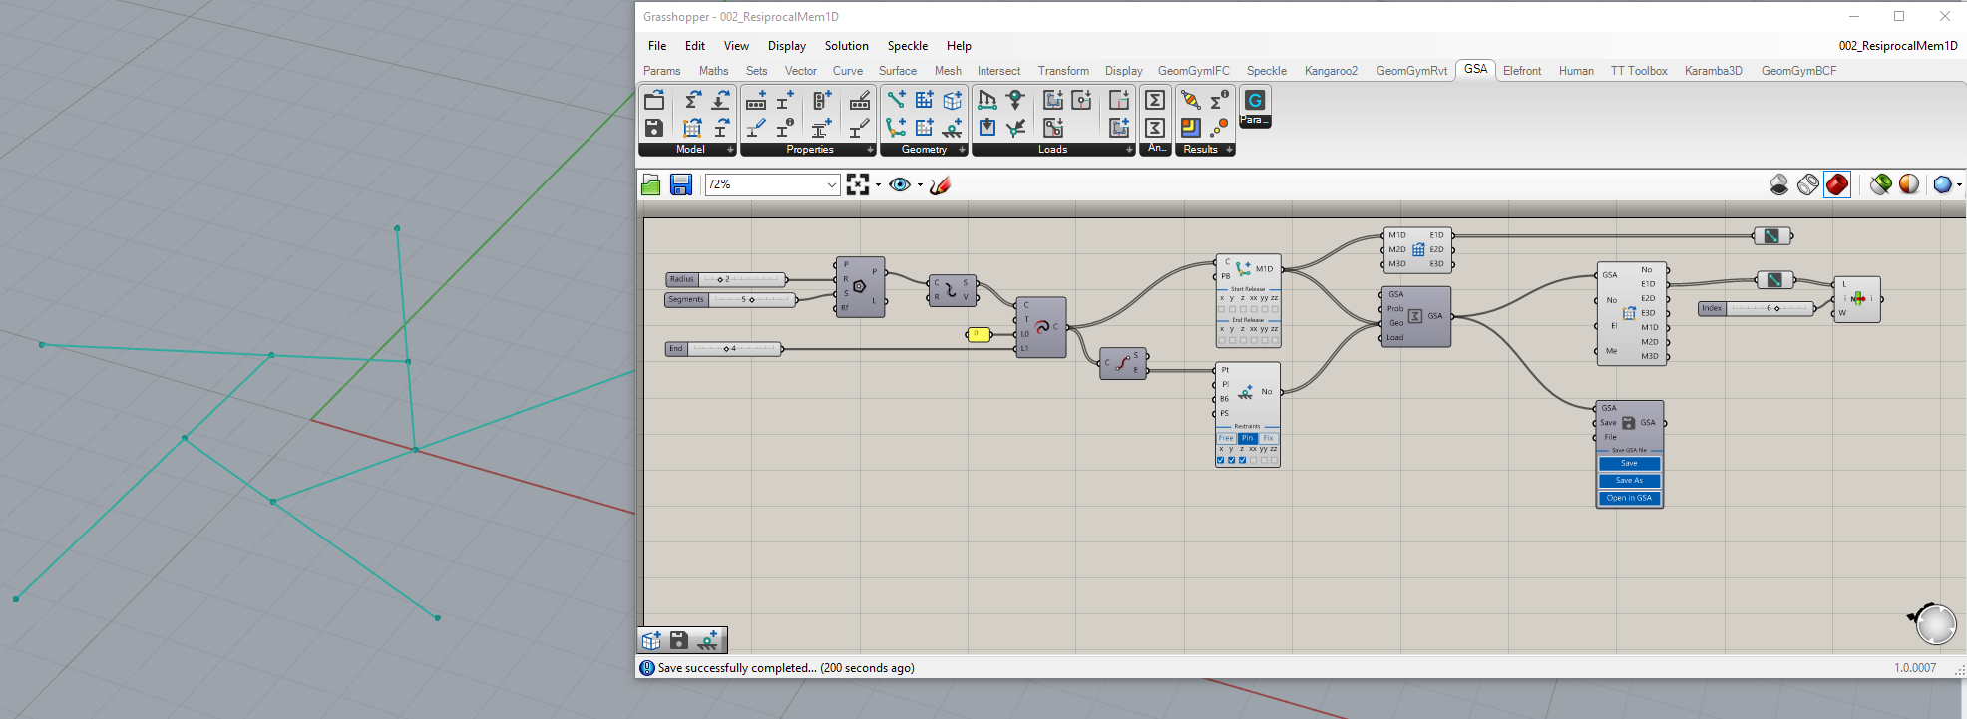
Create Geometry Examples [Live Demo]

Slide 28
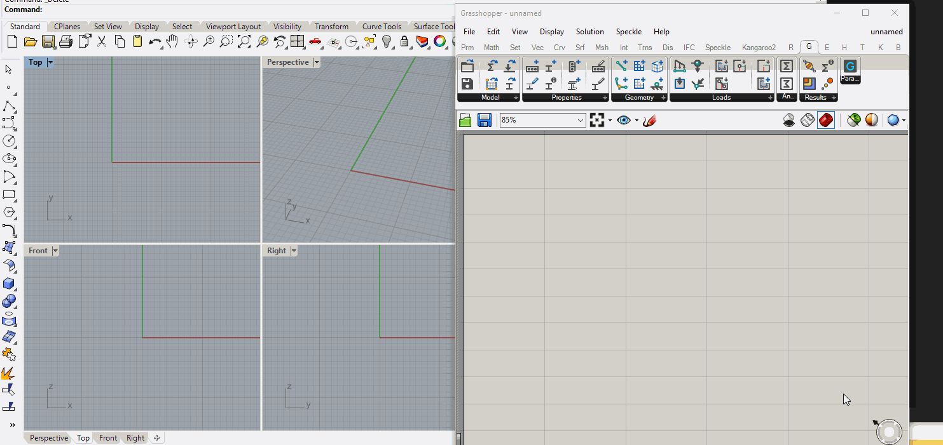
Create Member2D with inclusion Pt and Crv Example

Slide 29
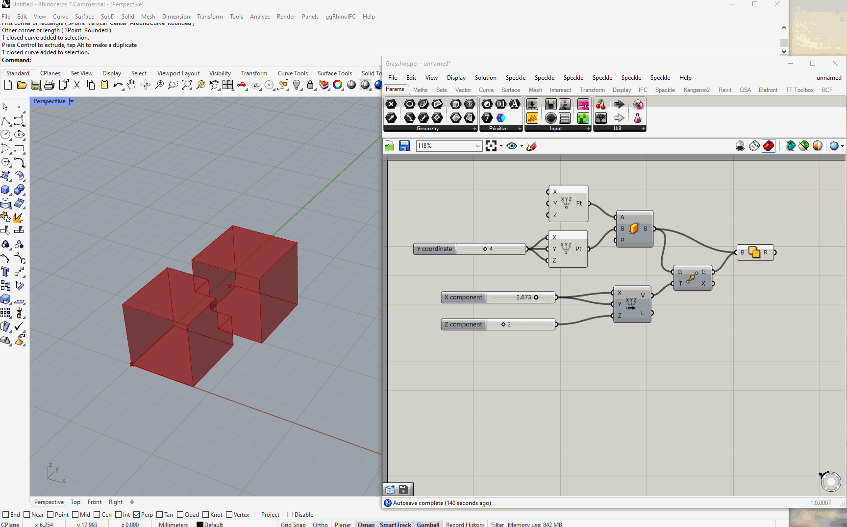
Create Member3D Example

Slide 30
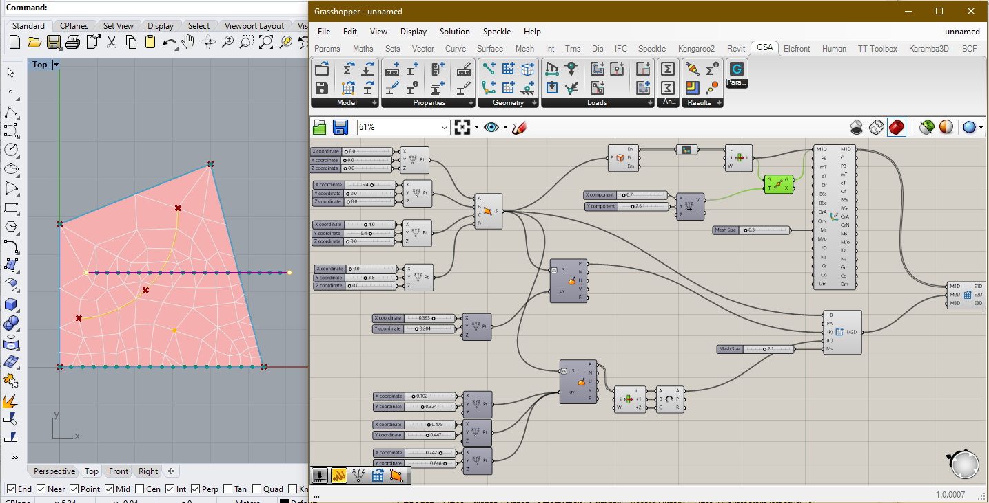
Create and Edit Member1D and Member2D Mesh Size [Live Demo]

Slide 31
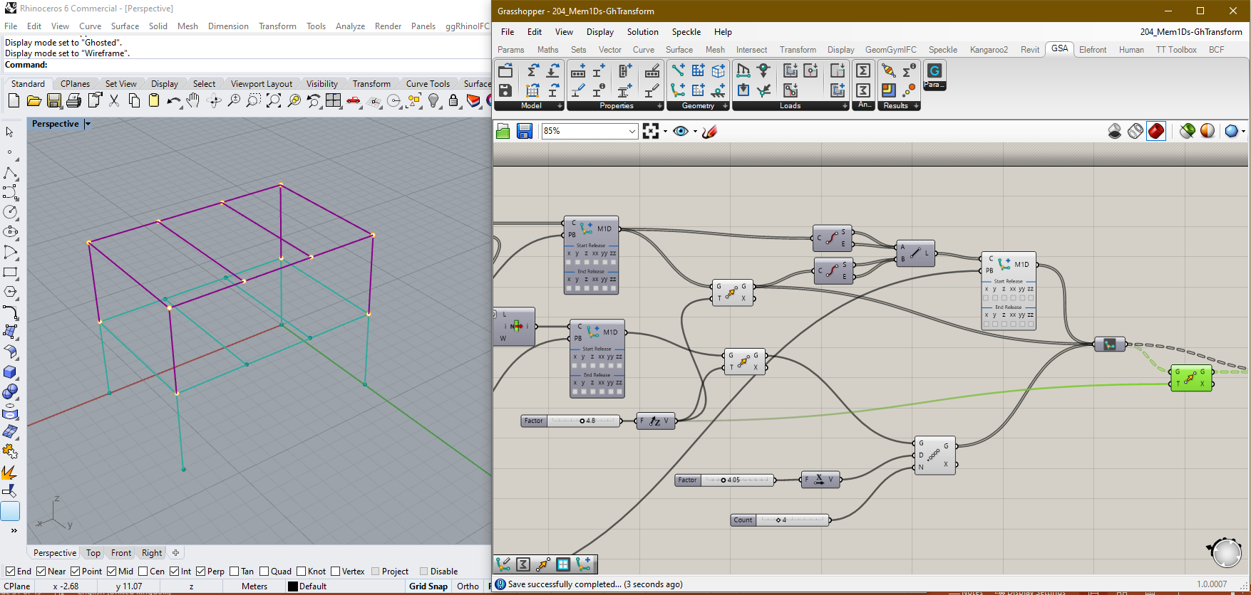
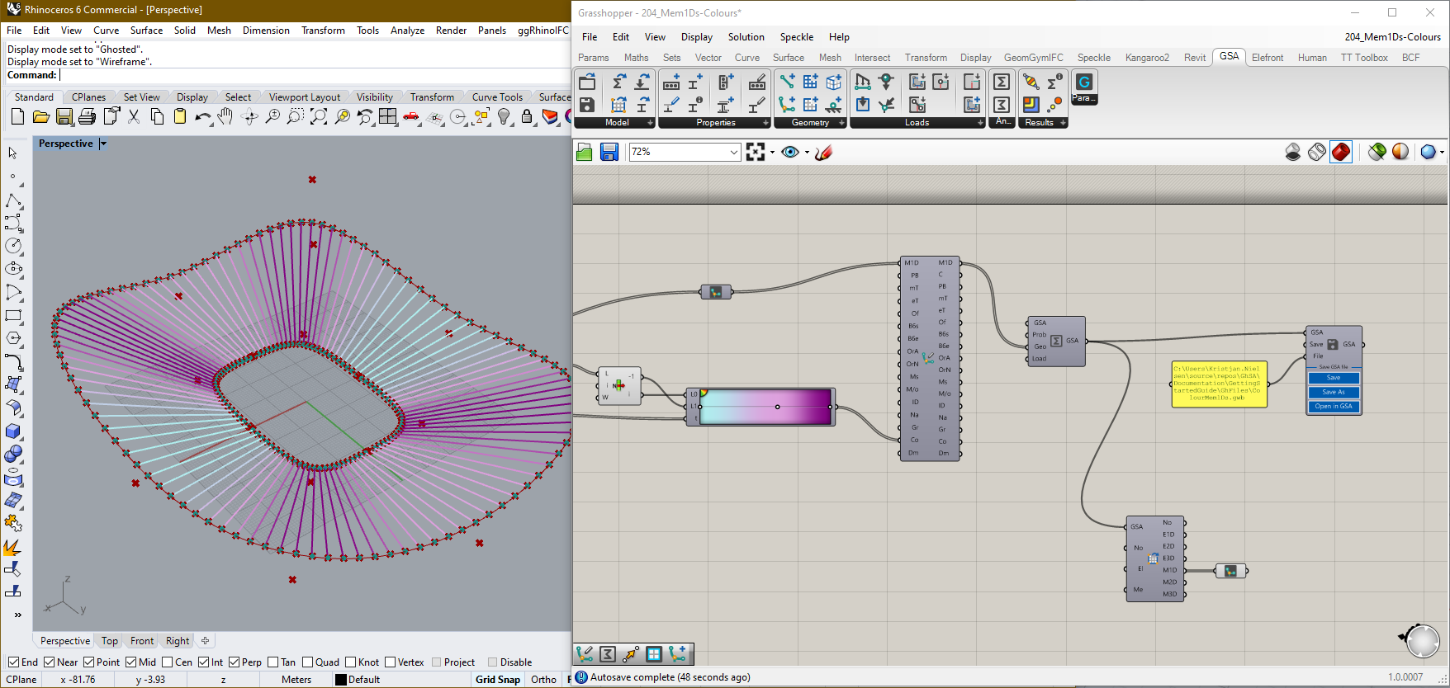
GH-Transform GSA Geometry and Colour Examples [Live Demo]

Slide 32
Working with IDs

Slide 33
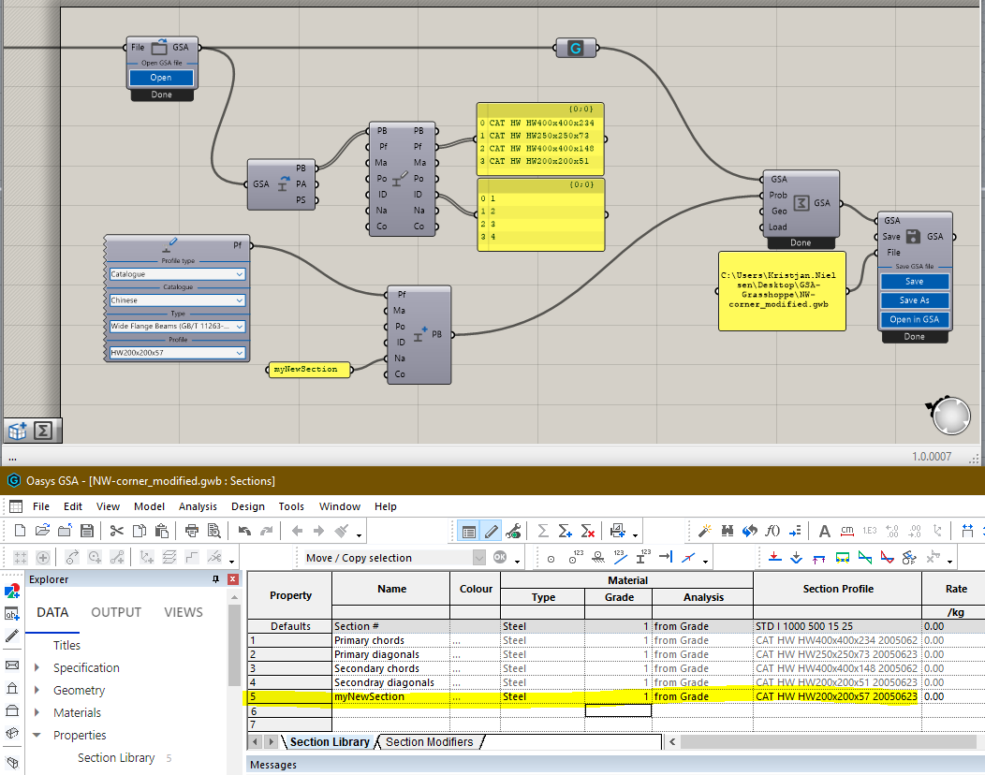
Section Properties in existing GSA Model. The model contains 4 sections
1
Create a new Section without setting the ID
2
3
Combine Existing GSA Model with new Property in Analysis component. Use Save to save the GSA Model with changes
Open the modified GSA Model in GSA. The Section Library now includes the new Section appended to the existing 4
4
Working with IDs – No ID set

Slide 34
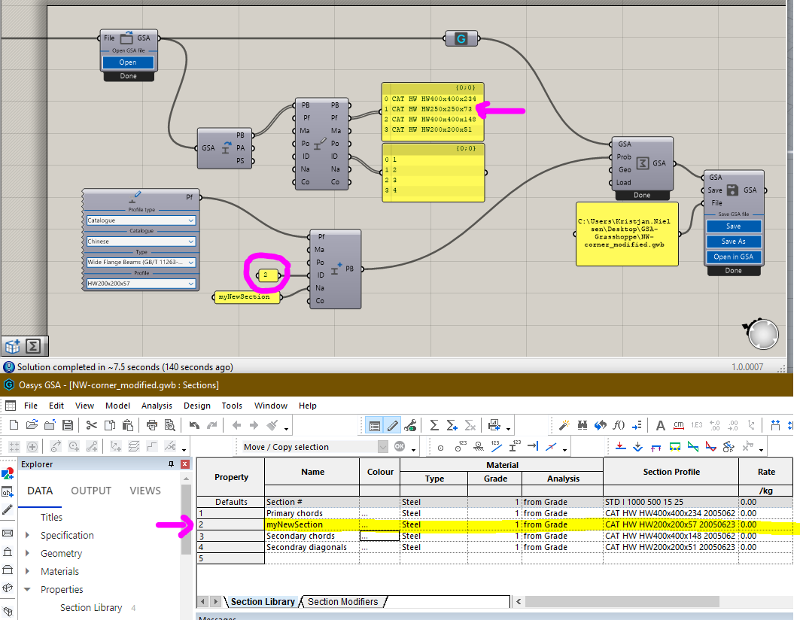
Section Properties in existing GSA Model
1
Set ID to a number bigger than 0 (zero) overwrite existing Property
2
3
Combine Existing GSA Model with new Property in Analysis component. Use Save to save the GSA Model with changes
Open the modified GSA Model in GSA. The old second with ID=2 has been replaced by the new Section
4
Working with IDs – SET ID

Slide 35
Section
Prop2D
Node
Element1D
Element2D
Member1D
Member2D
Member3D
Geometry
GridPlnSrf
Properties
Loads
GSA Grasshopper GridPlaneSurface has ID for both GridPlane and GridSurface, but not for Axis
Also note that Loads does not have ID and will thus always be appended
Working with IDs – GSA Parameters with IDs

Slide 36
Properties and Geometry
Relationship between Section/Prop2D and Elements/Members

Slide 37
Properties
Geometry
Element1D
1D
Section
Member1D
Element2D
Prop2D
2D
Member2D
Overview relationship Section/Prop2D with Elements/Members

Slide 38
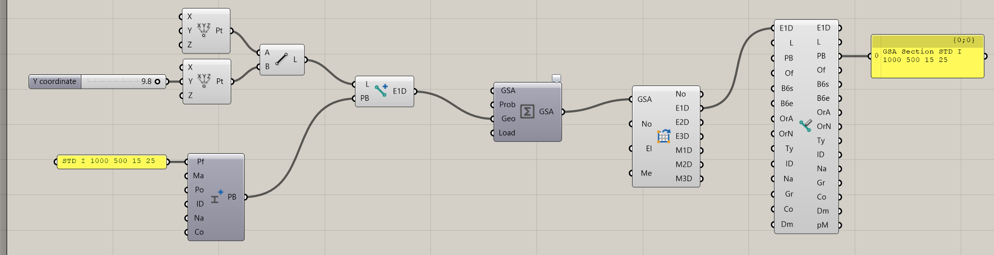
Create new Element1D from Line and input PB to attach this section to the Element1D object. The Element1D object will carry the Section with it around the GH script
2
3
1
Create new Section without ID (ID = 0). Section will be appended to end of existing Section Library
Assembling the model using Analysis Component can be done without inputting Section in “Prop”
Workflow Example 1

Slide 39
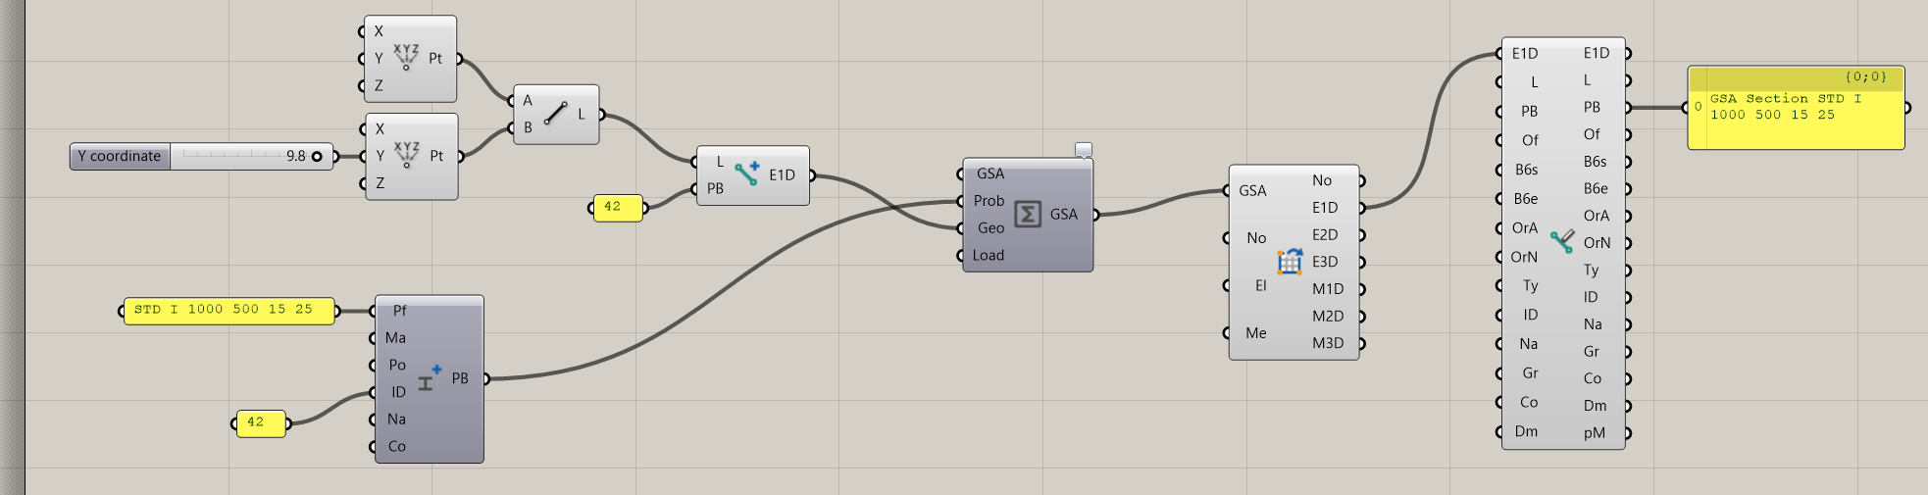
Create new Element1D from Line and input Integer (42 here) in PB-input to make reference to a Section number in the Section Library. Section may already exist in a GSA model and does not need to be created in Grasshopper
2
3
1
Create new Section with unique ID (ID = 42 here). Section will be set (and overwrite existing Section) in Section Library
Assembling the model using Analysis Component should be done with both Prop and Geo inputs, unless Section already exist in an existing GSA model
Workflow Example 2

Slide 40
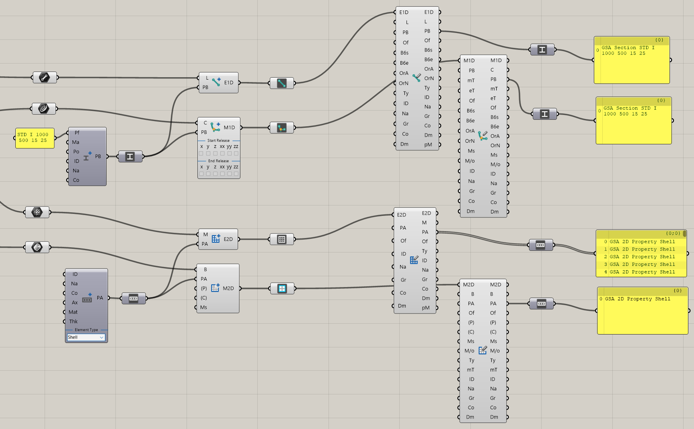
Edit components
Create components
1D
2D
Relationship between Section/Prop2D and Elements/Members

Slide 41
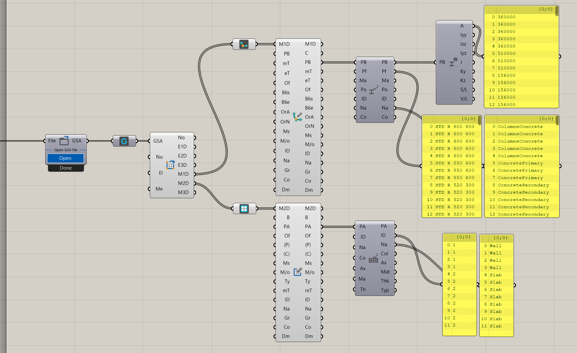
Edit components
SectionProperties
EditMem1D
EditSection
OpenModel
GetGeometry
EditProp2D
EditMem2D
Applies when opening Existing Model as well

Slide 42
Loads
Typical referenced by object

Slide 43
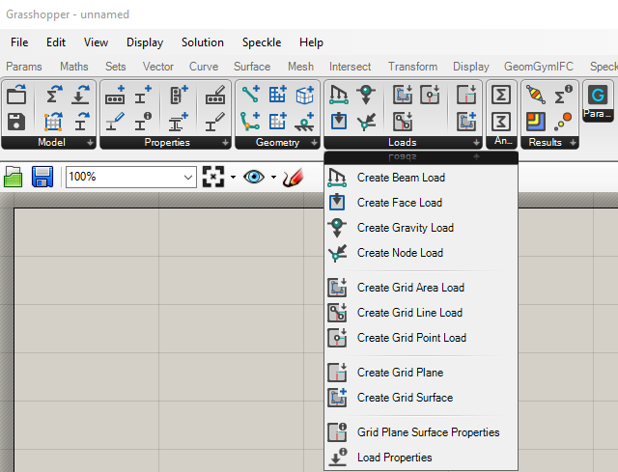
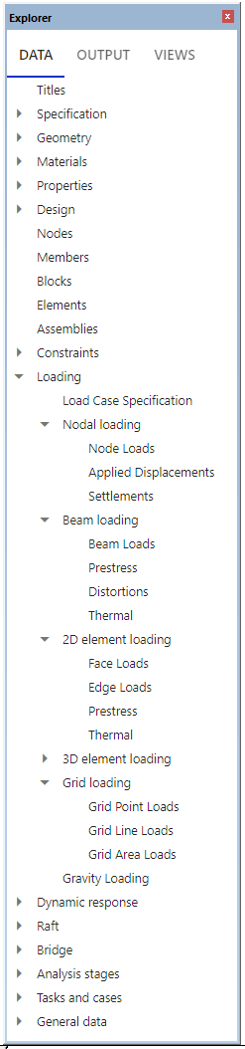
Load tab

Slide 44
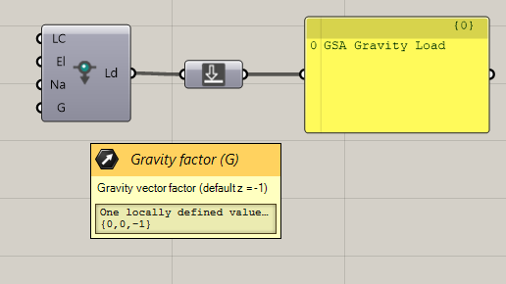

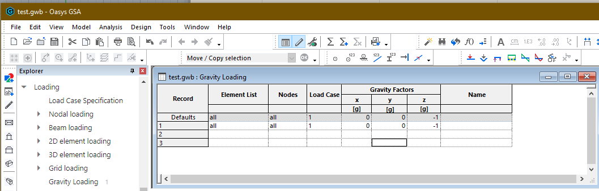
LC default = 1
List of elements default = “All”
Name is optional (default empty)
Gravity vector default = (0, 0, -1)
Typical Loads - Gravity

Slide 45
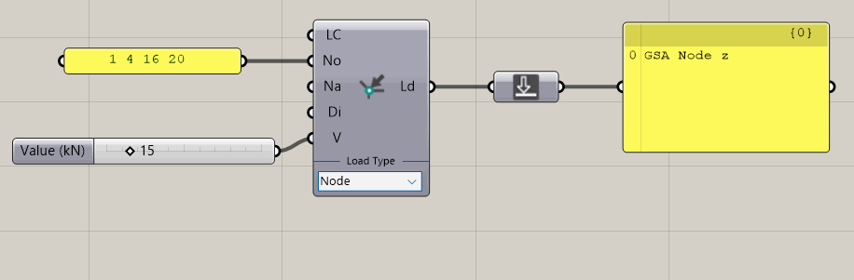
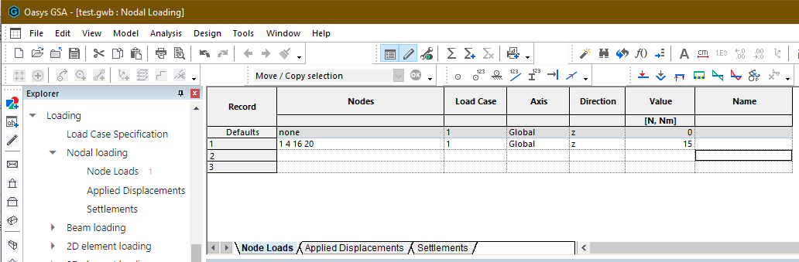
List of nodes in model to apply load to
Direction input: x, y, z, xx, yy, zz Default = z
Dropdown UI to change Load Type
Typical Loads – Node Load

Slide 46
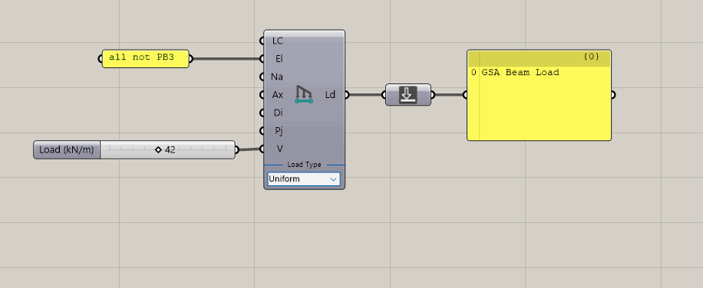
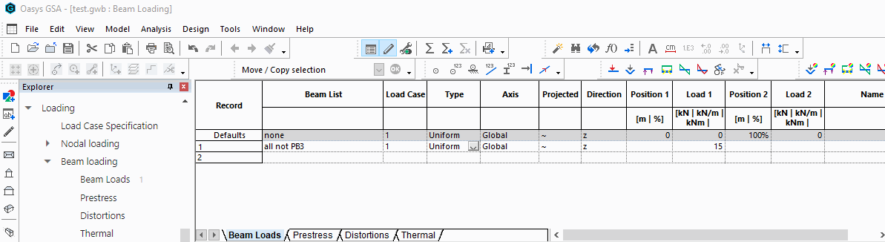
Axis: Global/Local - Default = Global
Direction: x, y, z, xx, yy, zz - Default = z
Projection: True/False - Default = False
Load Value and Position (t) adjusts with selected Load Type
Dropdown UI to change Load Type
Typical Loads – Beam Load

Slide 47
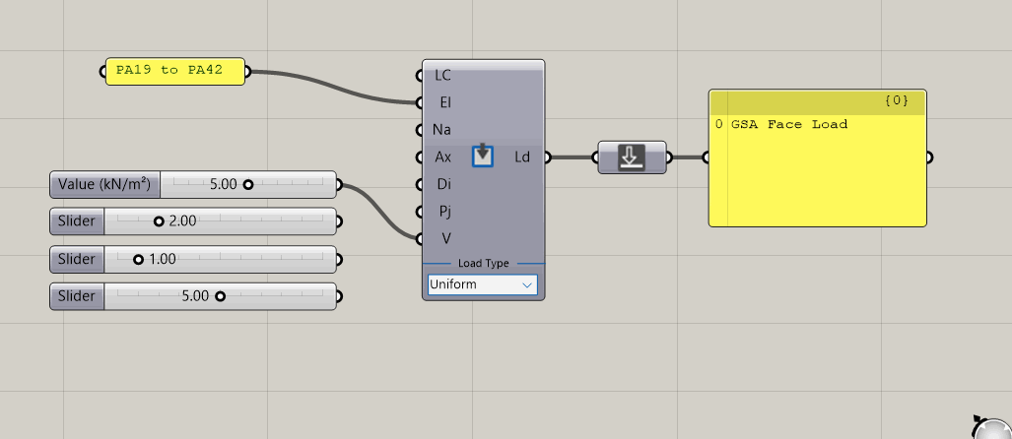

Axis: Global/Local - Default = Local
Direction: x, y, z, xx, yy, zz - Default = z
Projection: True/False - Default = False
Dropdown UI to change Load Type
Load Value and Position (t) adjusts with selected Load Type
Typical Loads – Face Load

Slide 48
Grid Loading
Automatically Expanded loads

Slide 49


GridPlaneSurface Parameter – Grid Plane

Slide 50


GridPlaneSurface Parameter – Grid Surface

Slide 51


GridAreaLoad Wind Load Generator Example [Live Demo]

Slide 52
Analyse

Slide 53

Analysis tab

Slide 54

Analysis tasks coming soon
Model
GSA Model
GSA Model
Open Model
Save Model
Properties
Section
Prop2D
Offset
Spring
Bool6
Geometry
Node
Element1D
Element2D
Member1D
Member2D
Member3D
Loads
Load
GridPlnSrf
Node Res.
1D Results
2D Results
Analyse
Results
GSA Grasshopper Workflow

Slide 55
Results

Slide 56

Results tab

Slide 57

Analysis of simple cantilever [Live Demo]

Slide 58

Analysis of 4 point surface [Live Demo]

Slide 59
Limitations

Slide 60

Known bugs and limitations
Current state of the plugin is Alpha – things might break, and things will change. (It is however getting close to a final state with the current components)
Materials cannot be created at all – GSA-Grasshopper material parameter to be developed
Analysis tasks cannot be created – GSA-Grasshopper analysis task parameter to be developed
Spring parameter not working at all (placeholder in plugin for now)
Prop2D thickness cannot be set
Releases cannot be set in neither Element1D or Member1D
CreateProfile Catalogue lookup sometimes fails
OpenModel sometimes returns empty model when re-using the button
Settings for Elements and Members not fully covered
Tolerance cannot be set for Grid Surface
Meshing of 2D Members can become really slow on medium-large models
Using filters on GetGeometry not covering PB-terminology
Results components are WIP, use with care (e.g. proper self-checking of results values)
No results for Load Combinations are available
Units cannot be change (placeholder in plugin for now). Use [kN-m] for now
Titles cannot be set (placeholder in plugin for now)
No graphical visualisation of restraints, releases or cross-section available
Conflict with referenced dll when running analysis and having Karamba3D plugin installed

Slide 61
1
2
Rhino Command:
TestPackageManager
3
Installing GSA-Grasshopper

